Slide 1
CROSS LAYER TRACING IN KUBERNETES
Runzhou Han
Aditya Chechani
Reet Chowdhary
Taiga: https://tree.taiga.io/project/msdisme-2018-bucs528-template-7/
GitHub: https://github.com/BU-NU-CLOUD-SP18/Cross-Layer-Tracing-in-Kubernetes

Slide 2
Review
Kubernetes
Ingress
Ingress controller
Nginx
Haproxy
Service
Tracing
Data plane

Slide 3
Task Completed
Setup MOC
Deploy Kubernetes
Trace HotRod using Jaeger on MOC and locally
Get logs from Kubernetes Control Plane and make sense of it
Create a flask application and deploy in Kubernetes
Get Nginx Logs locally

Slide 4
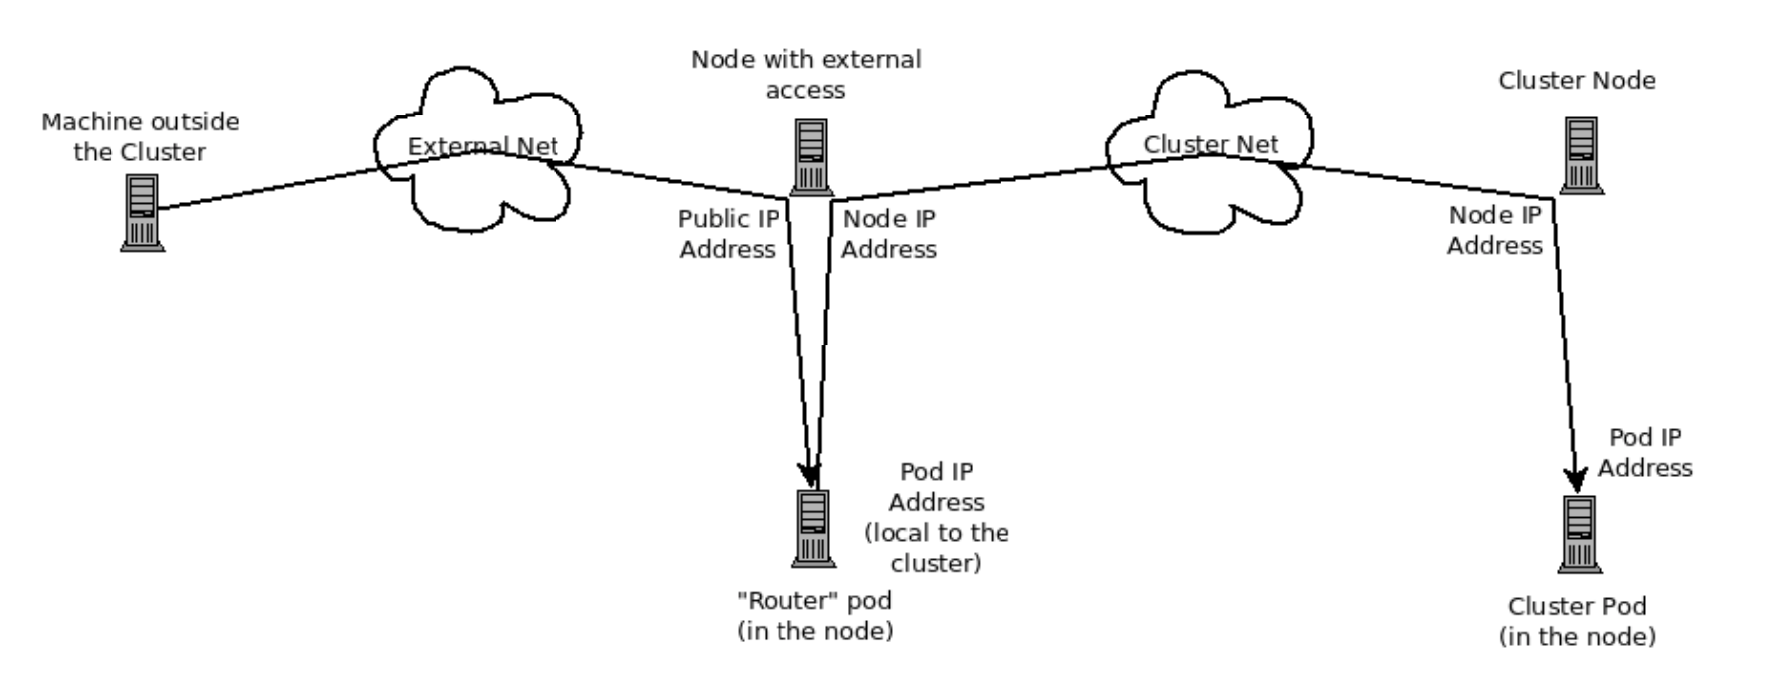
Kubernetes Data Plane
Ingress controller & Load balancer like nginx & HAproxy

Slide 5
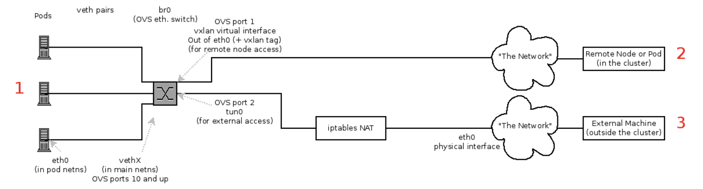
Kubernetes Data Plane

Slide 6
Ingress
Ingress is a collection of rules that allow inbound connections to reach the internal cluster services
In order for ingress to work the cluster must have an Ingress controller running
Currently GCE and nginx are supported, some instances of the documentation indicates that HAproxy is the load balancer
The plan is to add trace points to nginx or HAproxy in the next sprint in order to trace ingress

Slide 7
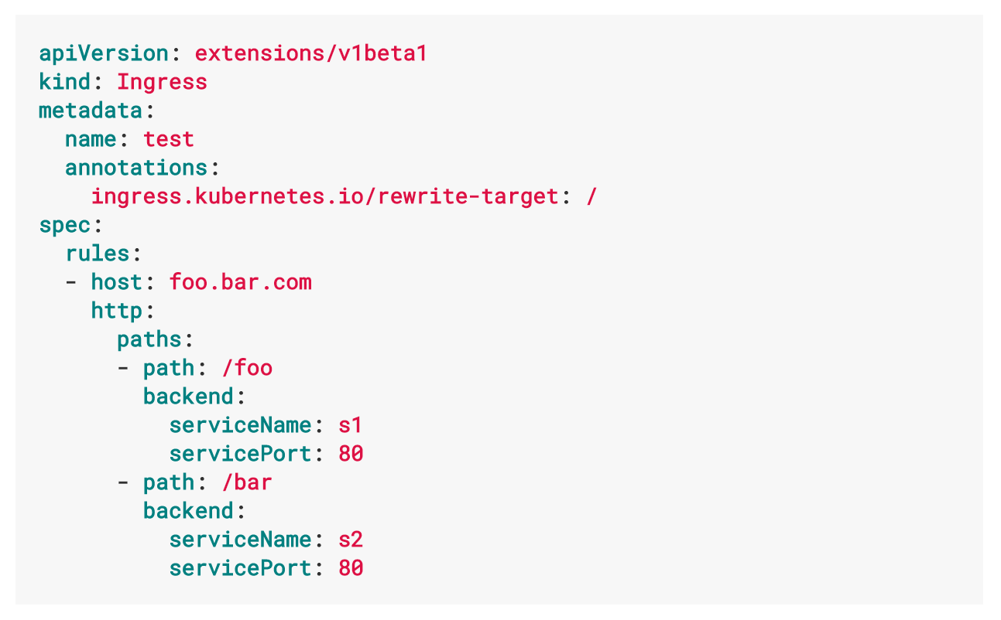

Slide 8
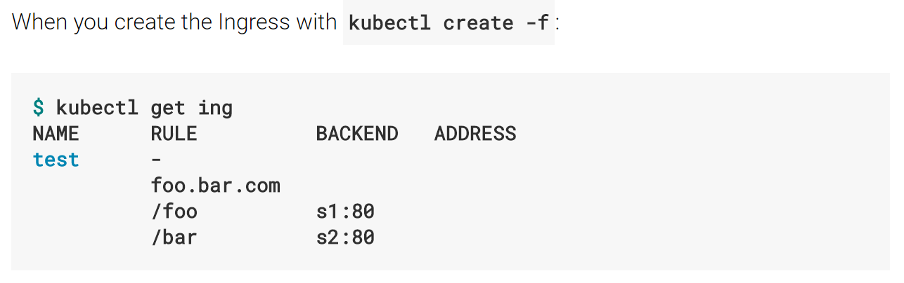

Slide 9
Containerizing and Deploying Flask
In order to display the functionality of Kubernetes Ingress features we decided to use a Flask app
The application returns a simple HTML response upon receiving a GET request
We were able to containerize the application and deploy it and receive a response from it on the local network
We must now expose the application to the outside world and send the requests through the ingress

Slide 10
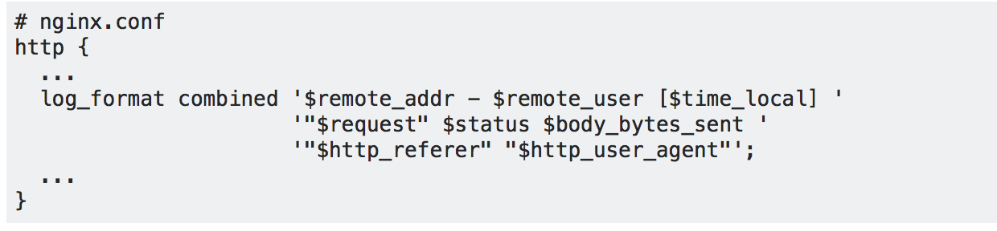
Change in Plan:
Deploy a simple containerized flask application in Kubernetes
Establish communication from outside world
Get logs/traces from the Ingress Controller (Nginx).
Figure out where the trace points can be added in Nginx
If time permits, look into OVS switch which is responsible for communication between nodes inside Kubernetes.

Slide 11

Some Issues
Frequent Connection issues
Recently kubectl is timing out after we’re already on the master node

Slide 12
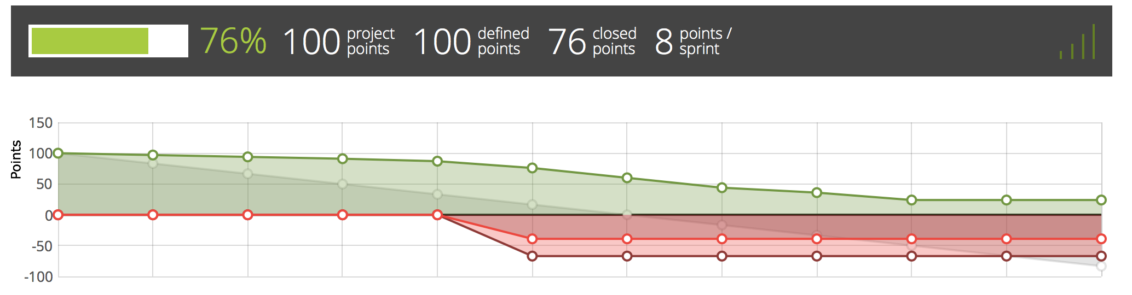
Taiga Burndown chart

Slide 13
Release Planning
■In sprint 5, we will:
–Add tracing points to Kubernetes ingress controller
–Show that we can collect tracing events of Kubernetes
■In final sprint, we will:
–Compare Kubernetes tracing and application tracing

Slide 14
Questions?

